Slide 1
The meeting will start promptly at 1:30PM.
Please silence all cell phones.
Please sign in on the sign-in sheet or
send list of attendees to
Bran.Pollard@Alaska.gov
Notes:
Good afternoon everyone.
Thank you very much for attending; I appreciate it.
My name is Bran Pollard and I’m the design project manager for this project.
Joining me today are DOT staff from our highway and bridge design, construction and contracts groups as well as Michael Baker International, who is helping us with CMGC support services.
Can everyone please silence your cell phones and sign in on the sheet or email me at bran.pollard@Alaska.gov?

Slide 2
Alaska Department of
Transportation & Public Facilities
Herring Cove Bridge Improvements CMGC
IRIS Number SFHWY00072, Federal Project Number 0902043
Southcoast Region
July 25, 2019
Notes:
We’re here today for this Contractor outreach meeting for the Herring Cove Bridge Improvement project.
This project will use an alternative contracting method; Construction Manager/General Contractor or CMGC.

Slide 3
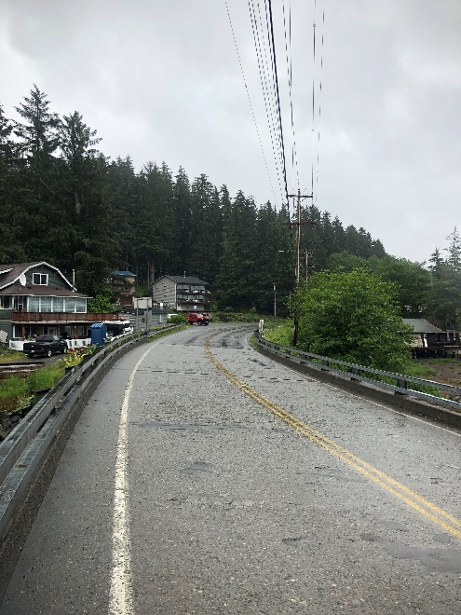
Project Scope & Purpose
Scope: Replace the Herring Cove Bridge and provide pedestrian accommodations.
Purpose:
Replace Herring Cove Bridge
Pedestrian Improvements
Wood Road Intersection Improvements
Rehabilitate South Tongass Highway
Notes:
The scope of the project includes replacing the Herring Cove Bridge and providing pedestrian accommodations.
The purpose of the project is to:
Replace the bridge, which is approximately 66 years old and has surpassed the 50 year design life which it was originally constructed for
Construct pedestrian improvements including pedestrian pathways on both sides of the bridge
Construct improvements at the intersections of South Tongass Highway at Wood Road and Powerhouse Road
And rehabilitate South Tongass Highway between those two intersections

Slide 4
Need
The Herring Cove Bridge is structurally deficient
Herring Cove is an environmentally rich ecological habit
Non-motorized users frequent the area to view wildlife
Notes:
The need for the project includes:
The Herring Cove bridge is structurally deficient; structural problems with the bridge deck, in particular, have resulted in the bridge being rated as “poor” in the NBIS Bridge rating system
Herring Cove is an environmentally rich ecological environment; there is also a hatchery in the cove on the upstream side of the bridge
Non-motorized users frequent the Herring Cove area to view wildlife

Slide 5
Need
Tour operators frequently stop on the bridge and unload tourists to view the area.
Narrow shoulders in the area create conflicts between motorized and non-motorized users
Notes:
The need for the project also includes:
Tour operators frequently stop on the bridge and unload tourists to view the area
Narrow shoulders in the area create conflicts between motorized and non-motorized users, especially during the summer tourist season
Without proper facilities, pedestrians are using the roadway, which obstructs traffic and creates unsafe situations

Slide 6
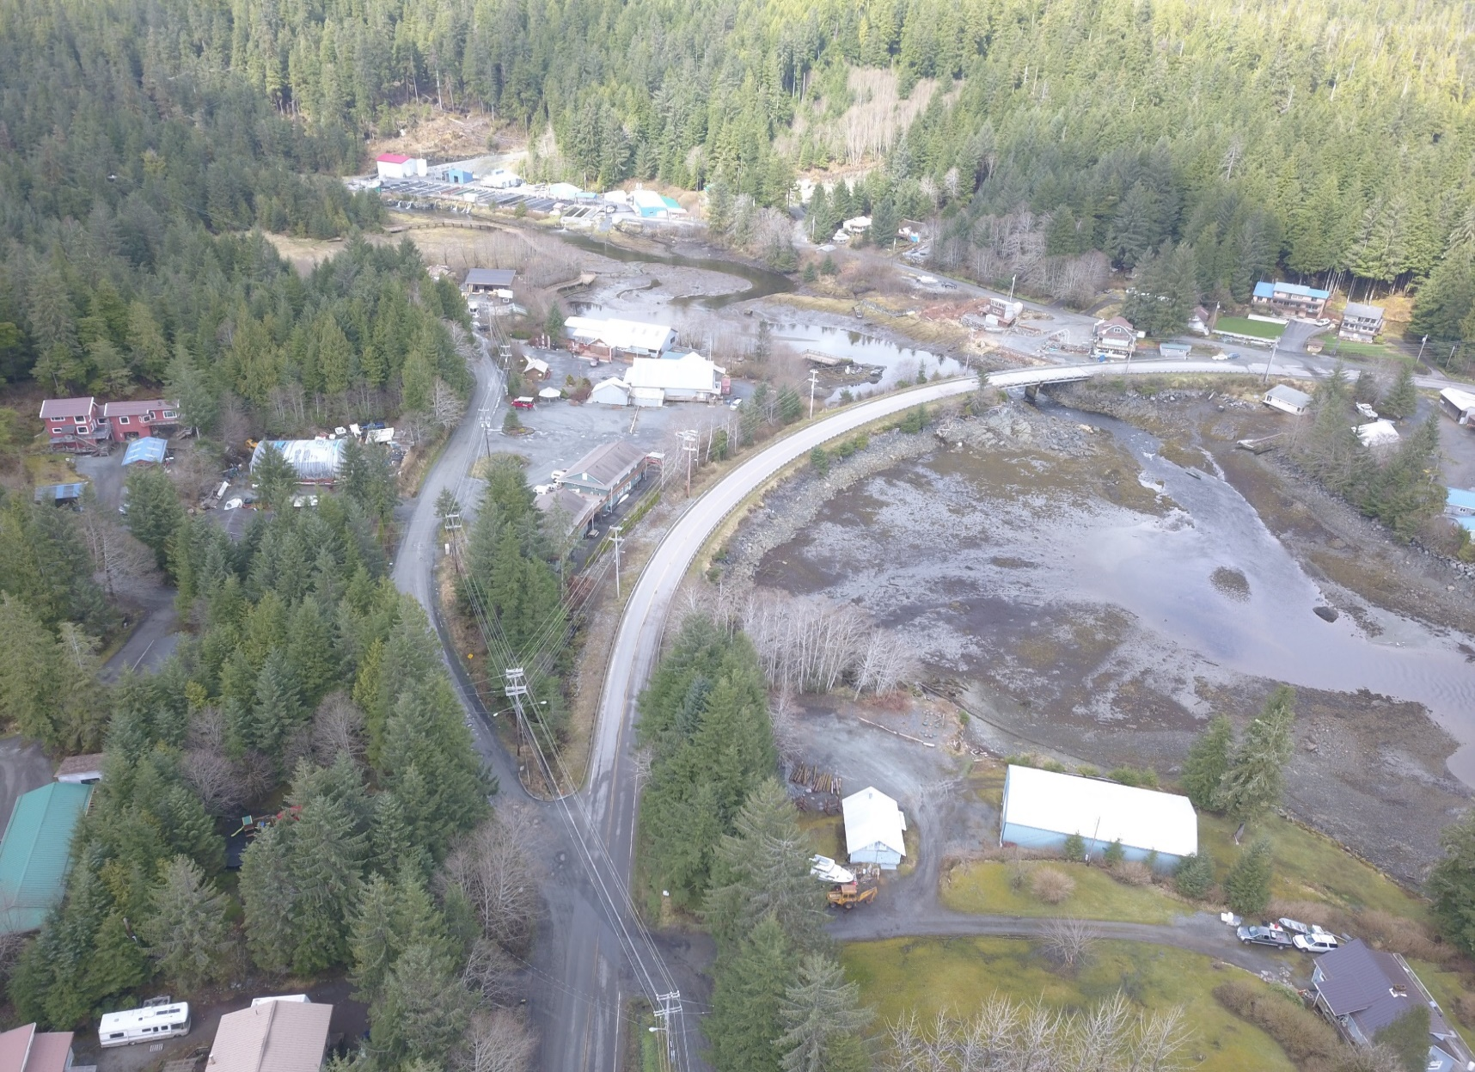
Herring Cove Site
Notes:
Here’s an aerial photo of the site, facing north; in the picture you can see:
South Tongass Highway, the bridge and Herring Cove in the middle-right
Wood Road and it’s intersection with the highway on the bottom-left
Powerhouse Road and it’s intersection with the highway on the upper-right
We’ve put up some project maps and figures around the room, for reference

Slide 7
Project Goals
Improve safety and mobility
Enhance non-motorized use
Enhance visitor experience
Maintain traffic control during construction
Develop a constructible cost effective design
Notes:
Project goals include:
Improving safety and mobility
Enhancing non-motorized use
Enhancing the visitors’ experience
Maintaining traffic control during construction
And developing a constructible, cost-effective design

Slide 8
Project Goals
Minimize ROW and utility impacts
Identify construction obstacles and develop innovative solutions
Maintain a high level of public satisfaction during construction
Create a high quality construction project
Initiating construction as soon as practicable
Notes:
Project goals also include:
Minimizing ROW and utility impacts
Identifying construction obstacles and developing innovative solutions
Maintaining a high level of public satisfaction during construction
Creating a high quality construction project
And initiating construction as soon as practicable

Slide 9
CMGC Goals
Create a collaborative owner/contractor relationship
Share and transfer knowledge
Identify, mitigate, and minimize risk
Support innovation
Improve design constructability
Optimize the project schedule
Meet budget goals
Notes:
CMGC goals include:
Creating a collaborative owner/contractor relationship
Sharing and transferring knowledge
Identifying, mitigating and minimizing risk
Supporting innovation
Improving design constructability
Optimizing the project schedule
And meeting budget goals

Slide 10
Innovations
What innovations do you have for:
  Bridge installation
  Limiting ROW needs and impacts
  Drainage improvements and culvert replacements
  Reducing impacts to local residents and traffic
  Finding efficiencies
  Reducing future maintenance costs
  Relocating overhead utilities
  Others?
Notes:
We would like to know what innovations you have for:
Bridge installation?
Limiting ROW needs and impacts?
Drainage improvements and culvert replacements?
Reducing impacts to local residents and traffic?
Finding efficiencies?
Reducing future maintenance costs?
Relocating overhead utilities?
Others?

Slide 11
Risk Allocation
Known risks for this project include:
  Narrow right-of-way
  Utility conflicts
  Traffic Control
  Project Constructability
Notes:
Regarding risk allocation; known risks for this project include:
Narrow right-of-way
Utility conflicts
Traffic control
Project constructability

Slide 12
Current Schedule
NTP for CMGC Project Stage October 2019
Design Study Report (DSR) 4th Qtr 2019
Plans in Hand (PIH) 4th Qtr 2019
Review PS&E 1st Qtr 2020
Final PS&E 2nd Qtr 2020
Negotiate Final Construction Cost 3rd Qtr 2020
NTP for CMGC Project Stage 2 3rd Qtr 2020
Substantial Completion 4th Qtr 2021
Notes:
Our current schedule is:
NTP for CMGC project stage 1 services in October this year
Design Study Report and Plans-In-Hand in the 4th quarter of this year
Review PS&E in the 1st quarter of next year
Final PS&E in the 2nd quarter of next year
Negotiate final construction cost and NTP for CMGC project stage 2 in the 3rd quarter next year
And substantial completion by the 4th quarter of 2021
Now I’m going to turn the presentation over to Derek Christianson with Michael Baker International

Slide 13
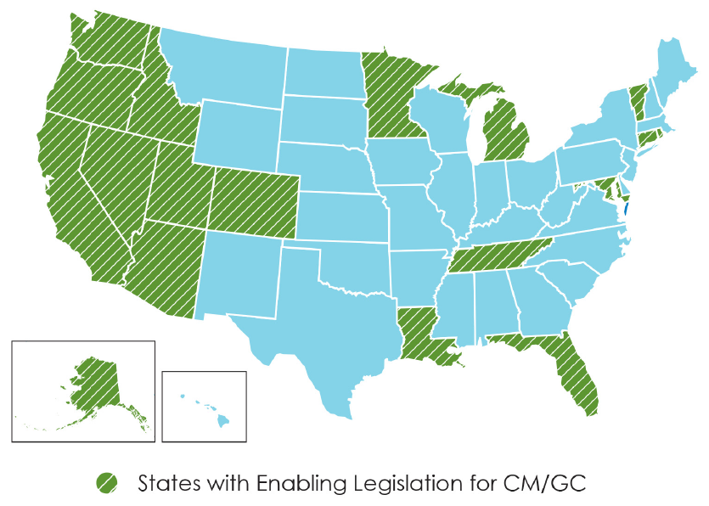
CMGC use around the US
Notes:
Derek
Available for use across United States.
Several states using it – WA, OR, CA, UT, CO, MN, MI, LA, etc.
The first DOT&PF horizontal construction project was the Riley Creek Bridge project at Mile 237 of the Parks Highway.
Also used for some public facilities such as the crime lab in Anchorage and also used to procure Marine Ferry vessel

Slide 14
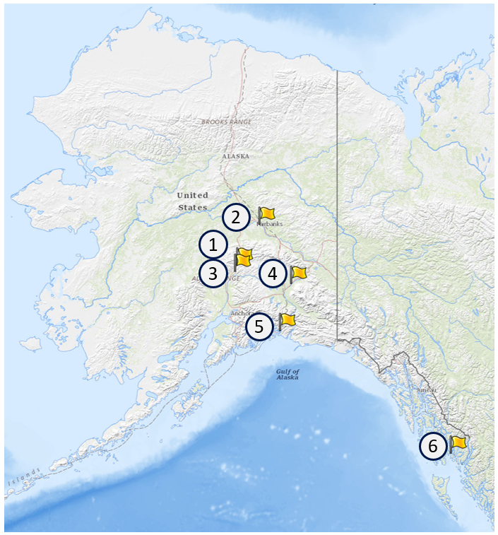
ADOT&PF’s CMGC Experience
Parks Hwy MP 237 Riley Creek Bridge
University Avenue Rehab
Parks Hwy MP 231
Tok Cutoff MP 38-50
Cordova Whitshed Road
Ketchikan Herring Cove Bridge
Notes:
Derek
Used on projects as listed.

Slide 15
CMGC Overview
Introduce Innovation
Promote Transparency
Demonstrate Accountability
Create Efficiencies
Notes:
Derek
Strategic plan:
Transparency
CMGC provides a framework for open, transparent communication between the Department, the contracting community, and agency stakeholders.
Accountability
CMGC creates a partnership between the Department and the Contractor for the duration of the project, leading to greater accountability.
CMGC allows the Department and the Contractor to actively manage risk, leading to improved accountability when issues arise or changes occur.
Innovation
CMGC’s emphasis on teamwork and open communication drives innovation by providing opportunities to evaluate new technologies and techniques prior to construction.
Create Efficiencies
CMGC’s collaborative approach between design, construction, and the Contractor reduces the transition time from design to construction.
Contractor perspective gained from CMGC projects can be utilized to reduce risks, provide innovations, and account for Contractor’s means and methods when developing other transportation projects.
FHWA Every Day Counts: initiative has identified CMGC as a method to reduce delivery time and introduce innovations due to collaboration and risk management
ce delivery time and introduce innovations due to collaboration and risk management

Slide 16

CMGC Team Approach
Project Development Team:
  Owner (ADOT&PF)
  Designer (ADOT&PF)
  Independent Cost Estimator (ICE)
  Contractor (CMGC)
Notes:
Derek
Note the different roles.
All four members of the team must work together for the project to succeed.

Slide 17
Project Development Team
ADOT&PF Design
  Bran Pollard, P.E., Design Project Manager
  Travis Eckhoff, P.E., Design Engineer
  Colleen Ivaniszek, Designer
ADOT&PF Construction
  Michael Lukshin, P.E., Construction Group Chief
ADOT&PF Contracts
  Jeff Jenkins, Chief of Contracts
Notes:
Derek

Slide 18
Project Development Team
CMGC Assistance - Michael Baker International
  Derek Christianson, P.E., CMGC Lead
  Karin McGillivray, CMGC Facilitation
  Anne Brooks, P.E., Contractor Outreach Coordinator
Independent Cost Estimator (ICE) – Stanton
  Ed Jones, Lead Estimator
  Gary Lindley, Civil Estimator
Notes:
Derek

Slide 19
Project Development Team
CMGC Contractor
  Who will be your Contract Manager?
  Who will be your Project Manager?
  Who will be your Project Superintendent?
  Who will be your Cost Estimator?
  Who will be your Scheduler?
Notes:
Derek
Note the strengths that each team member may bring to the project.
Individuals may fill one or more of these team member positions.

Slide 20
Procurement Comparison
CMGC requires collaboration during detailed design
 | Design-Bid Build |  | Design Build |  | CMGC
 | Owner | Contractor | Owner | Contractor | Owner | Contractor
Preliminary Design | ✔️ |  | ✔️ |  | ✔️
Detailed Design | ✔️ |  |  | ✔️ | ✔️ | ✔️
RFP/Bid/TMP | ✔️ | ✔️ | ✔️ | ✔️ | ✔️ | ✔️
Construction |  | ✔️ |  | ✔️ |  | ✔️
Notes:
Derek
Compare different procurement types at each phase of project delivery.

Slide 21
CMGC Development Stages
Notes:
Derek
Schedule overview.

Slide 22
Project Development Stages
Notes:
Derek
Starts with a request for proposal.
Stage 1 includes preliminary design, detailed/final design – all conducted with contractor input.
Stage 2 begins if and when DOT&PF and the Contractor agree on the Theoretical Maximum Price.

Slide 23
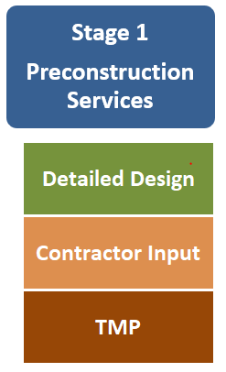
Stage 1: Preconstruction Services
Collaboration
  Design innovations and efficiencies
  Identifying construction impacts
  Constructability reviews
  Cost estimates and project pricing
  Identifying and mitigating risks
  Permitting assistance
Notes:
Derek
Greatest collaboration and knowledge transfer occurs during this phase
Riley Creek examples: functional roles during meetings – estimator, superintendent, construction engineer, principal, etc.

Slide 24
Stage 1: Preconstruction Services
Risk Mitigation:
  Identify, track and manage risk
  Eliminate or minimize risk
  Owner retains design control
Notes:
Derek
Risk is more equitably shared and reduced overall.
Addressing risk during design, not construction. Allows us to eliminate risk early before it can get expensive.

Slide 25
Stage 1: Preconstruction Services
Value Added:
Early impact identification
  Permitting
  ROW
Risk management
  Change orders
  Claims
Maximize innovation and efficiencies
Improved quality
Notes:
Derek
Addressing issues with the contractor during design instead of during construction is a more cost effective approach.

Slide 26
Stage 1: Preconstruction Services
Schedule:
Permitting assistance
Enhanced utility coordination
Construction sequencing
Notes:
Derek
Contractor adds specificity to how the project will be constructed.
Designers often have to make assumptions that may or may not be correct.

Slide 27
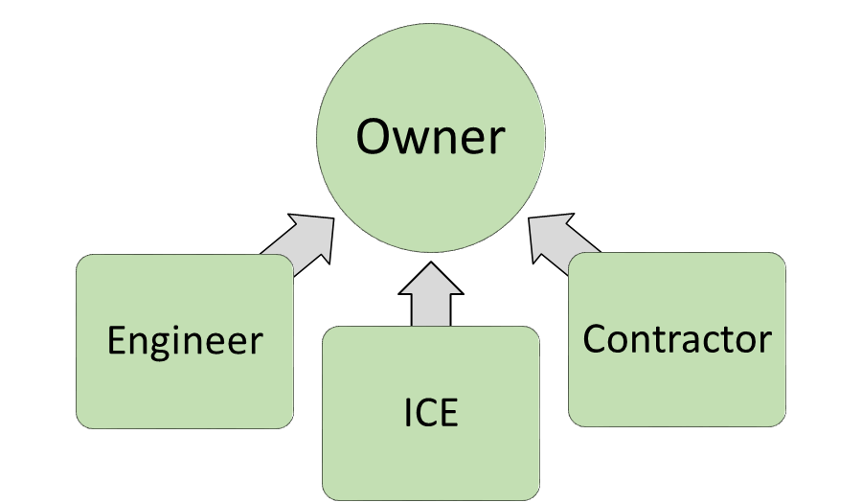
Stage 1: Preconstruction Services
Pricing
Engineer’s estimate
Contractor Estimate
Independent Cost Estimate
Notes:
Derek
Fair pricing creates transparency for the project.
Not looking for the low bid; want a price that is reasonable based on reasonable means and methods proposed by contractor.
Will build bottom up cost estimates – labor rates, equipment rates, production rates, etc.
Blind bid evaluation; contractor’s numbers will be available to DOT; contractor will not see DOT’s numbers

Slide 28
Stage 1: Preconstruction Services
Negotiations
Negotiate Theoretical Maximum Price:
  If agreement is reached – proceed to Construction
  If agreement is not reached – proceed to advertise for Bids
Notes:
Derek

Slide 29
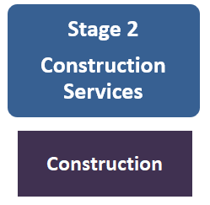
Stage 2: Construction
Theoretical Maximum Price Acceptance
Similar to DBB at this point
Notes:
Derek
Typically “business as usual” at this point, i.e. construction is similar for CMGC and Design-Bid-Build.

Slide 30
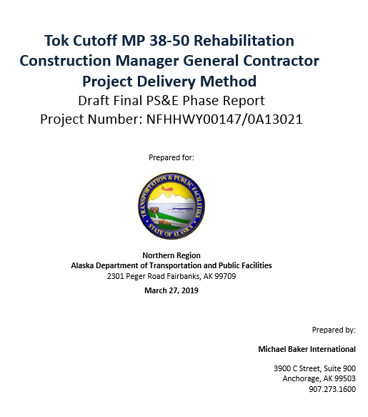
Post Construction Evaluation
Innovation evaluation
Risks encountered
Change orders & claims
TMP vs. final costs
Changes to schedule
Notes:
Derek
We will track these elements during preconstruction and after construction.
Part of lessons learned process for DOT.

Slide 31
Request for Proposal
RFP
  RFP to select CMGC began advertising July 9, 2019
  5 weeks to prepare response
  Proposals due August 13, 2019
  CMGC selection September 2019
  Opportunities available for subcontractors
Notes:
Jeff

Slide 32
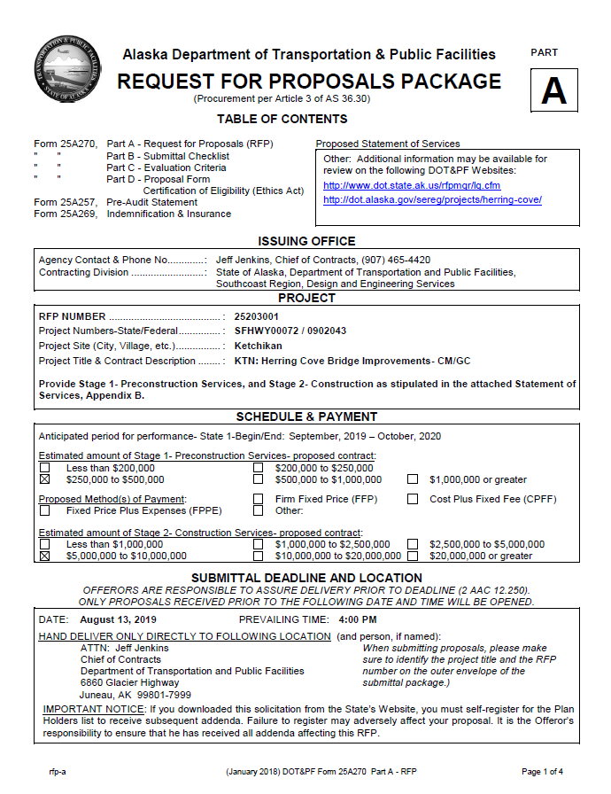
Request for Proposal
RFP
Part A – Request for Proposal
Part B – Submittal Checklist
Part C – Evaluation Criteria
Part D – Proposal Form, Certification of Eligibility
Pre-Audit Statement
Indemnification and Insurance
Proposed Statement of Services
Notes:
Jeff

Slide 33
Request for Proposal
RFP
Part C in this CMGC RFP has two sections that require responses in submitted proposals:
Section I - Technical Proposal
Section III – Price
  Responses are not required for criteria with a Weight of “0”
Notes:
Jeff

Slide 34
Part C - Section I Technical
RFP
15 page maximum written narrative responding to weighted criteria
Responses must be specific and directly related to the Contracting Agency’s Proposed Statement of Services (Appendix B of the RFP)
Notes:
Jeff
Past performance doe not necessarily have to be past CMGC experience
Major difference with DBB and new to most contractors
Discuss weighting & scoring of selection criteria
Assistance of a technical writer is suggested

Slide 35
Part C - Section I Technical
RFP
Section I Weighted Criteria:
    Project Approach (20% weight)
    Risk Management (10% weight)
    Innovation (15% weight)
    Partnering & Claims Mitigation (5% weight)
    Proposed Staff (10% weight)
    Management (5% weight)
    Past Performance (10% weight)
    Approach to Fee and Price (10% weight)
Notes:
Jeff
Past performance doe not necessarily have to be past CMGC experience
Major difference with DBB and new to most contractors
Discuss weighting & scoring of selection criteria
Assistance of a technical writer is suggested

Slide 36
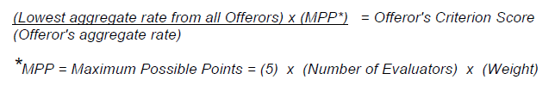
Part C - Section III Price
RFP
Labor Billing Rates (5% weight):
    Contract Management - 10% of total labor effort
    Project Management - 25% of total labor effort
    Project Superintendent - 25% of total labor effort
    Cost Estimating - 25% of total labor effort
    Scheduling - 15% of total labor effort
    Response will be scored as follows except the score will be zero if a rate for each listed function is not provided by an Offeror:
Notes:
Jeff

Slide 37
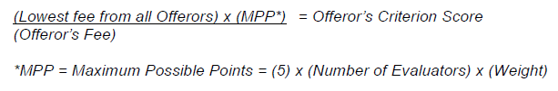
Part C - Section III Price
RFP
Total Price Proposal (10% weight):
    Fee expressed as a percentage and consists of overhead, profit, and any other applicable indirect costs
    Profit does not need to be identified separately
    Combine all three components to form a single fee percentage
    Applied to all work directly performed by the prime contractor
    A 5% fee (not the proposed fee) will be allowed for the Prime Contractor on subcontractor work or subcontractor-supplied materials
    Joint ventures or prime/subcontractor partnerships will be treated as one entity and entitled to the proposed fee
    Response will be
    scored as follows:
Notes:
Jeff

Slide 38
Opportunities for DBE
RFP
State of Alaska is Race Neutral for Federal Highway Administration funded Projects.
  Contractors are encouraged to use DBEs to ensure ADOT&PF meets its overall DBE utilization program goal of 8.83% to maintain Race-Neutral status.
Notes:
Jeff

Slide 39
Q&A and Addenda
RFP
Q&A will be posted on the RFP website as supplemental information through an addendum to the RFP:
  May need to re-download Zip File to get supplemental information
Only those listed on the RFP holders list will be notified of addenda (Please Register)
Notes:
Jeff

Slide 40
For more information
Project Manager
      Bran Pollard, P.E., ADOT&PF Design
      Tel: 907-465-4526
      E-mail: bran.pollard@alaska.gov
      Fax: 907-465-1763
      TDD: 800-770-8973
Project Web site:
    http://dot.alaska.gov/sereg/projects/herring-cove/index.shtml
Procurement Web Site:
    http://dot.alaska.gov/rfpmgr/lg.cfm
Notes:
Bran

Slide 41

Questions?
How can we help you provide the best proposal to ADOT&PF?
Notes:
Bran

